Slide 1
Credit Card Fraud Detection
PRESENTED BY:
NIRDESH SINGH - 20BCE7062 ( nirdesh.20bce7062@vitap.ac.in )
GAURAV SHARMA - 20BCE7443 ( gaurav.20bce7443@vitap.ac.in )

Slide 2
ABSTRACT
The number of online payment options has expanded thanks to e-commerce and several other websites, raising the possibility of online fraud.
The primary purpose of the study is to create and implement unique fraud detection algorithm for streaming transaction data
We used a variety of machine learning algorithms like Decision Trees, Logistic Regression, Artificial Neural Networks and finally, Gradient Boosting Classifier that will be able to discern fraudulent from non-fraudulent ones.

Slide 3
INTRODUCTION
Detecting credit card fraud entails finding fraudulent purchase attempts and rejecting them rather than executing the sale.
Payment cards are simple to use since identifying your account and authorising the transaction simply need sending a small amount of digits to the bank.
The cost of credit card theft to the worldwide economy exceeds $24 billion annually, and the amount is rising.
The effects of fraud are more severe for smaller retailers, which is why it's crucial to have procedures and tools in place to identify fraud early on.

Slide 4
Literature survey/Related Work
A decision tree-based model that combines Luhn's and Hunt's algorithms has been put out by Prajal Save. To detect if an incoming transaction is fraudulent or not, Luhn's algorithm is employed.
Three machine-learning techniques were described and put into use to find fake transactions. The performance of classifiers or predictors is assessed using a variety of metrics, including the Vector Machine, Random Forest, and Decision Tree.
The Random Forest classifier was employed to train it on the behavioural traits of credit card transactions.
Numerous supervised learning algorithms, from the traditional to the contemporary, have been taken into consideration. These include of Bayesian methods, hybrid algorithms, deep and traditional neural networks, tree-based algorithms, and so forth.

Slide 5
Experimental design/ Methodology
Credit Card Dataset used
Data Exploration
Data Manipulation
Data Modelling
Fitting Logistic Regression Model
Fitting a Decision Tree Model
Artificial Neural Network
Gradient Boosting (GBM)
AUC-ROC Curve

Slide 6
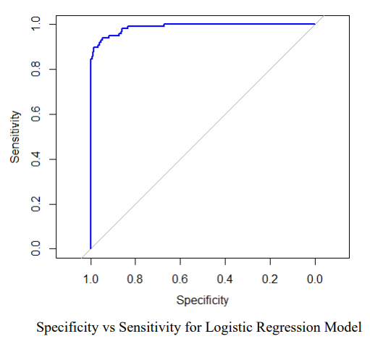
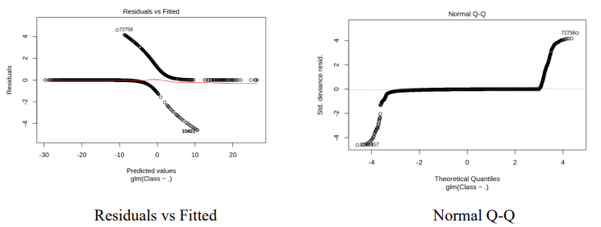
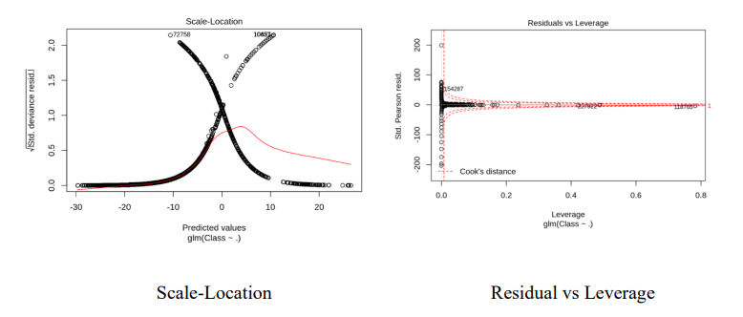
Results and Discussion
Logistic Regression
Precision – 0.9875
Accuracy – 0.9993855

Slide 7
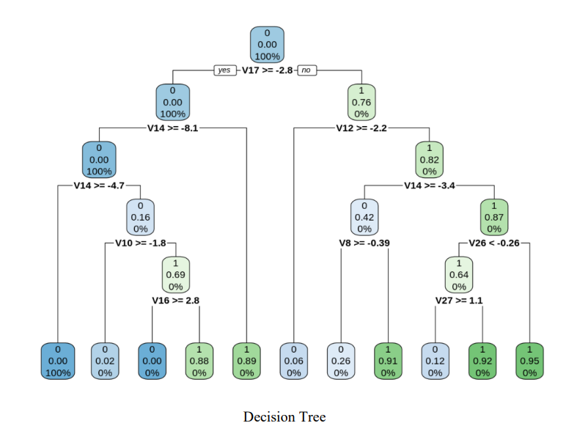
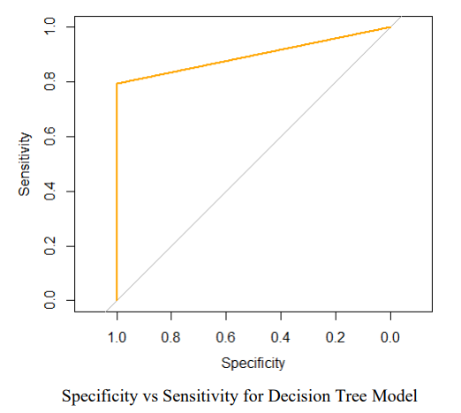
Decision Tree
Precision – 0.8973
Accuracy – 0.7412339

Slide 8
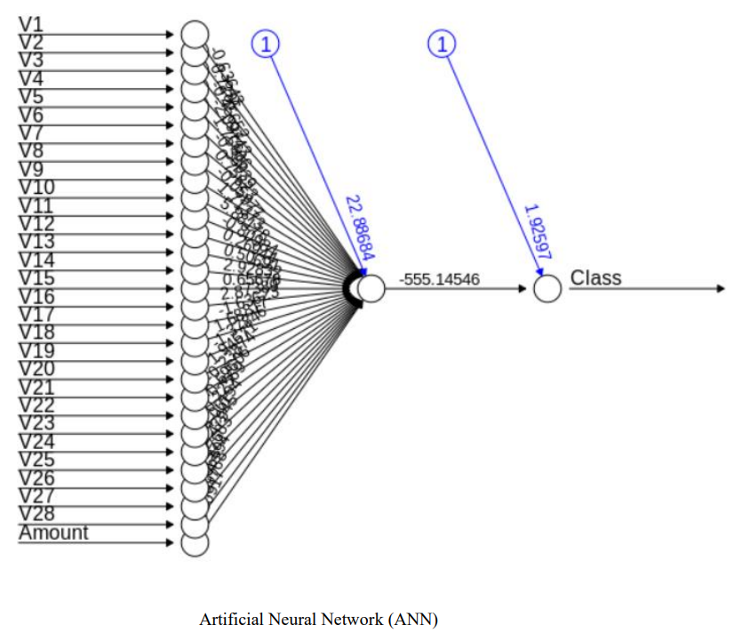
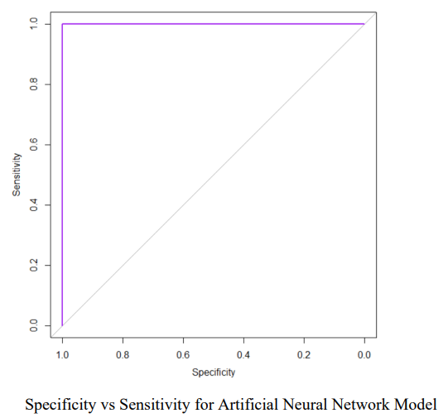
Artificial Neural Network
Precision – 0.9999
Accuracy – 0.9998947

Slide 9
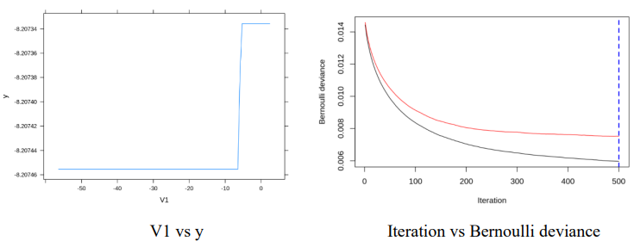
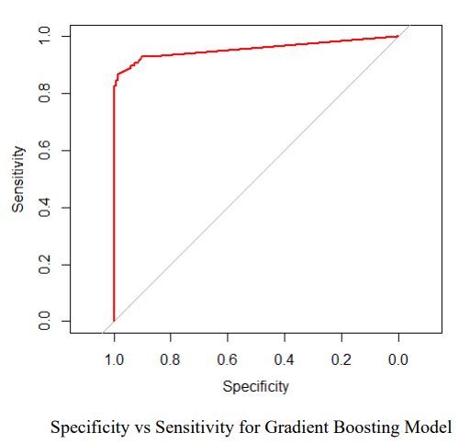
Gradient Boosting
Precision – 0.9555
Accuracy – 0.9993504

Slide 10
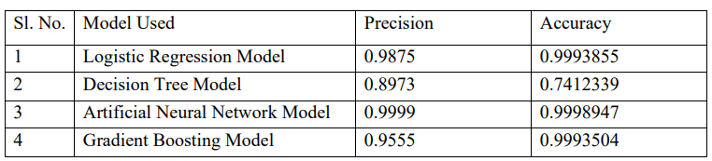
Table of Models' Accuracy and Precision

Slide 11
Future scope and Limitation
Even though we fell short of our objective of 100% accuracy in fraud detection, we did manage to develop a system that, given enough time and data, may get very near to that objective. There is some potential for improvement here, as with any effort of this nature. Due to the nature of the project, it is possible to integrate many algorithms as modules and combine their outputs to improve the final result's accuracy.
The absence of credit card databases is one of this's drawbacks. The dataset has more opportunities for development. When was previously shown, as the dataset size grows, the algorithms' accuracy rises. Consequently, additional data will undoubtedly improve the model's ability to identify frauds and decrease the amount of false positives. However, the banks themselves must formally approve this.

Slide 12
Conclusion
Unquestionably, using a credit card fraudulently is a criminal act of dishonesty. The most popular fraud schemes, as well as how to spot them, are listed in this article, which also reviews current research in the area. Along with the method, pseudocode, description of how it is implemented, and results of experimentation, this work has also provided a detailed explanation of how machine learning may be used to improve fraud detection. The algorithm's accuracy is greater than 99.98%, and its precision is 99.99%. This high proportion of precision and accuracy is predicted given the stark disparity between the amount of transactions that are legitimate and those that are real.

Slide 13
References
[1] Vaishnavi Nath Dornadula, “Credit Card Fraud Detection using Machine Learning Algorithms”, doi :10.1016/j.procs.2020.01.057.
[2] Aisha Fayyomi, Derar Eleyan, “A Survey Paper On Credit Card Fraud Detection Techniques”, ISSN 2277-8616.
[3] S P Maniraj, “Credit Card Fraud Detection using Machine Learning and Data Science”, doi : 10.17577/IJERTV8IS090031.
[4] P. Save, P. Tiwarekar, K. N., and N. Mahyavanshi, “A Novel Idea for Credit Card Fraud Detection using Decision Tree”, Int. J. Comput. Appl., vol. 161, no. 13, pp. 6–9, 2017, doi: 10.5120/ijca2017913413.
[5] S. Xuan, G. Liu, Z. Li, L. Zheng, S. Wang, and C. Jiang, “Random forest for credit card fraud detection”, ICNSC 2018 - 15th IEEE Int. Conf. Networking, Sens. Control, pp. 1–6, 2018, doi: 10.1109/ICNSC.2018.8361343.
[6] X. Yu, X. Li, Y. Dong, and R. Zheng, “A Deep Neural Network Algorithm for Detecting Credit Card Fraud”, Proc. - 2020 Int. Conf. Big Data, Artif. Intell. Internet Things Eng. ICBAIE 2020, pp. 181–183, 2020, doi: 10.1109/ICBAIE49996.2020.00045.

